Slide 1
COVID-19 Drug Therapy Prediction using open-source State Drug Utilization and FDA Adverse Events Data
Sandy Su
October 2021
Notes:
Accelerating the discovery of drug trends and patient risk factors on Azure
Add data sources using open-source data set X and X
COVID-19 Drug Therapy Insights using Drug Utilization and Adverse Events Data

Slide 2
Agenda
Executive Overview
Technical Design
Problem Statement
Architecture
Analysis
Demo
Q&A

Slide 3
Executive Overview

Slide 4
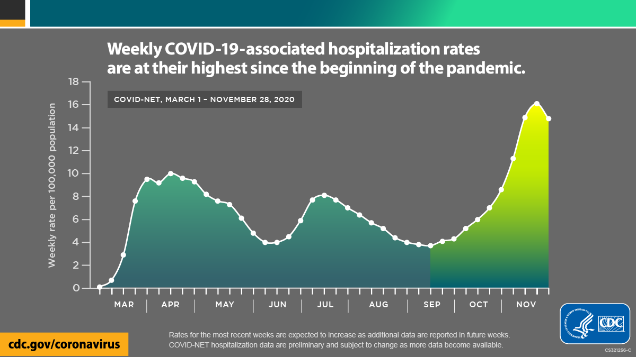
COVID-19 Hospitalizations - 2020
Notes:
https://www.cdc.gov/coronavirus/2019-ncov/covid-data/data-visualization.htm
This graph represents a rather sobering picture of where we were as a nation, 2 years ago in 2020.
At this time, in early 2020, COVID-19 was starting to make landfall in the United States, and the curves illustrate the hospitalization waves that ensued.
At the time of this publication, hospitalization rates were at their highest as we neared the winter months.

Slide 5
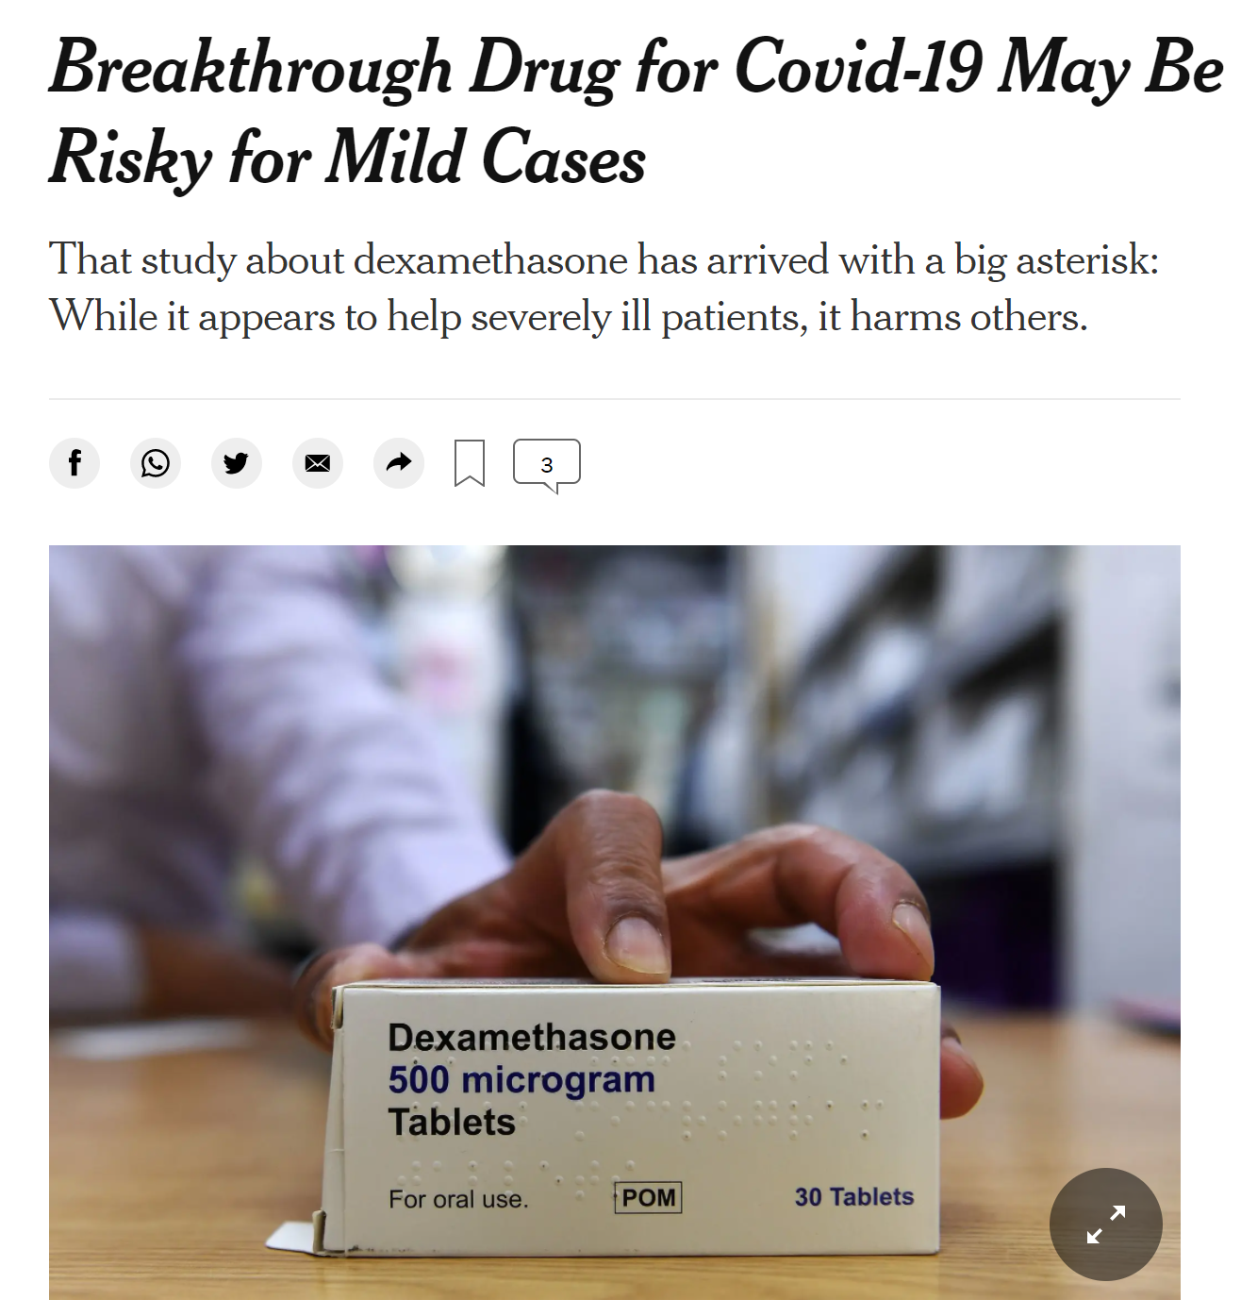
By Roni Caryn Rabin
Published June 24, 2020 Updated Sept. 2, 2020
“Scientists in Britain announced a major breakthrough in the battle against the coronavirus last week, reporting they had found the first drug to reduce deaths among critically ill Covid-19 patients.
The drug — a cheap, widely available steroid called dexamethasone — does seem to help patients in dire straits, the data suggest. But it also may be risky for patients with milder illness, and the timing of the treatment is critical.”
Notes:
https://www.nytimes.com/2020/06/24/health/coronavirus-dexamethasone.html
Throughout that year, as a society we were desperate for answers. A glimmer of hope came when existing drugs on the market were found to be able to treat critically ill patients.
Yet, researchers cautioned that the drug was not entirely safe for all patients.
Perhaps by necessity, these drugs caused some patients harm while helping others.
CAN WE DO BETTER?

Slide 6

Trending Now: Predictive Care Guidance
Healthcare can do better: Predictive Care
$5B
Medical virtual reality market by 2025 ³
$187B
Telehealth market likely to break by 2026 ¹
$317M
Projected global healthcare chatbots market by 2023 ⁴
47%
Healthcare organizations are already using patient data predictive analytics ²
44%
Medicare primary care visits that utilized telehealth methods rather than in-person visits ⁵
Notes:
1: Telehealth seems likely to break $185.6 billion by 2026
2: 47% of healthcare organizations are already using patient data predictive analytics
3: The market for artificial intelligence (AI) in drug development, valued at $200 million in 2015, ballooned to $700 million in 2018 and is predicted to value more than $5 billion in 2024, according to a report by Big Data Analytics
4: Future (MRFR) have published a report stating that the global healthcare chatbots market is expected to attain a CAGR of 21.10% during the forecast period of 2018 to 2023. The market projection in terms of valuation stands at USD 316.85 million by the end of the forecast period.
5:In April of 2020, 43.5% of Medicare primary care visits utilized telehealth methods rather than in-person visits
Resources:
https://mobidev.biz/blog/technology-trends-healthcare-digital-transformation
https://www.digitalauthority.me/resources/state-of-digital-transformation-healthcare/
http://analytics.dkv.global/data/pdf/AI-for-DD-Q2/Available-for-Purchase/Infographic-Summary-Advanced-R&D-and-Drug-Discovery-2018-Q2-Sample.pdf.
https://www.medgadget.com/
https://mobidev.biz/blog/technology-trends-healthcare-digital-transformation

Slide 7




Customer Journey
Michael Patient
Becca Nurse
Maria Physician
Jim Coder
1
Michael felt feverish, had severe headache, and visits emergency department due to the perceived severity of his symptoms.
Becca triages Michael’s condition and he was admitted into the ER where his vitals and other observational measures were recorded.
Jim receives automated email to initiate coding of diagnosis and procedures post-discharge in the billing unit.
Maria administer necessary treatment on Michael, transferred him to inpatient stay and prescribe drugs for pick at the Pharmacy.
2
2
3
4
5
6
Michael was discharged after 3 days length of stay [LOS] at the facility and noticeable improvement in his condition.
Jim identify information from patient records manually,
standardize it to ICD format, obtain DRG, and queue it into claims system.
Notes:
Photo source Jeff: https://www.gettyimages.com/detail/photo/senior-owner-wearing-eyeglasses-and-smart-casuals-royalty-free-image/1171689564?adppopup=true
Amy: https://www.gettyimages.com/detail/photo/portrait-of-smiling-mid-adult-woman-in-casuals-royalty-free-image/1250238615?adppopup=true
Monica: https://www.gettyimages.com/detail/photo/portrait-of-a-happy-mexican-businesswoman-royalty-free-image/1188966374
Erin: https://www.gettyimages.com/detail/photo/happy-female-brunette-ceo-wearing-blue-denim-shirt-royalty-free-image/1179627283?adppopup=true
Photo source Enrico: https://www.gettyimages.com/detail/photo/portrait-of-smiling-mid-adult-man-wearing-t-shirt-royalty-free-image/985138674?adppopup=true
Dan: https://www.gettyimages.com/detail/photo/doctor-wearing-eyeglasses-on-white-background-royalty-free-image/1139666077?adppopup=true

Slide 8
Demo (Front-end)

Slide 9
Technical Design

Slide 10
Problem Statement
2018–2021
What patterns were observed in drugs prescribed between 2018-2021?
Were any patterns related to the onset of COVID-19 in the US in 2019?
2019–2021
What Adverse Events were reported with these drugs from 2019-2021?
What risk factors were associated with patients who were given these drugs?

Slide 11
Data Sources
State Drug Utilization Data (SDUD)
Represents covered outpatient drugs paid for by state Medicaid agencies.
It has been reported by states since the start of the Medicaid Drug Rebate Program (MDRP) in 1990.
FDA Adverse Events Reporting System (FAERS)
Database that contains adverse event reports, medication error reports and product quality complaints resulting in adverse events submitted to the FDA.
Supports the FDA's post-marketing safety surveillance program for drug and therapeutic biologic products.
Notes:
https://www.medicaid.gov/medicaid/prescription-drugs/state-drug-utilization-data/index.html
https://www.fda.gov/drugs/surveillance/questions-and-answers-fdas-adverse-event-reporting-system-faers
DE Death
LT Life-Threatening
HO Hospitalization - Initial or Prolonged
DS Disability
CA Congenital Anomaly
RI Required Intervention to Prevent Permanent Impairment/Damage
OT Other Serious (Important Medical Event)

Slide 12





Data Personas
“I want to visualize which states had the highest concentration of COVID-related Rx”
“I need to easily amass millions of records of COVID data in one place”
“I need to restrict user access to patient PHI information”
Anna
Data Analyst
Roger
Data Engineer
Angela
Data Architect
“I want to identify the factors that caused a drug-related adverse event”
“I want to develop a risk prediction model for doctors prescribing drugs to treat COVID”
Daisy
Data Scientist Pro
Chen
Data Scientist Emerging

Slide 13

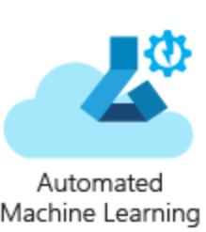








Architecture
Chen
Data Scientist Emerging
Build & Train
Model
Best model?
Roger
Data Engineer
No
Yes
Register Model
Deploy Model
Test Model
No
Data
Data
Movement
Pre- processing
Feature Engineering
No
Data
Storage
Best model?
Build & Train
Model
Revise
Model
Daisy
Data Scientist Pro
Yes
Angela
Data Architect
Anna
Data Analyst
Visualize
Operational Reporting

Slide 14




Technical Choices
 | Data Engineering | Feature Engineering | Build + Train | Package + Deploy | Operational Analytics | Visualization
Low Code/No Code Experience
Code-first ML experience
Code-first ML experience on Apache Spark
Notes:
Spark optimizations – demo optimizations vs. Synapse

Slide 15
Data Profile & Transformation - SDUD
Dataset Size (Rows, Columns)
Columns of interest:
Number of Prescriptions
Total Amount Reimbursed
Medicaid Amount Reimbursed
Geographical Latitude
Geographical Longitude
(14,557,421, 20)
Aggregate
Collect all drug utilization data from 2018-2020
Explore
Run statistics
Resolve Entities
Store
Create temp tables for initial querying
Plot trends in top drugs prescribed for 2020
Save data to ADLS for downstream processing in Synapse and map visualization in PowerBI
Plot trends in drugs prescribed to treat COVID-19
Perform entity resolution where multiple names exist for the same drug
Visualize

Slide 16
Data Profile & Transformation - FAERS
Dataset Size (Rows, Columns)
Columns of interest:
Demographics (4,428,351, 25)
Drug (19,295,493, 20)
Indication (13,307,632, 4)
Outcome (3,404,644, 3)
Reaction (14,540,496, 4)
Report Sources (172,516, 3)
Therapy (7,063,925, 7)
Manufacturer, Age, Weight, Sex, Route, Dose Amount, Occurrence Country, Dechallenge, Rechallenge, Drug Name, Product Active Ingredient, Drug Role Code, Dose Frequency
Aggregate
Collect all historical adverse events from 2019-2021
Join
Join relevant tables on primaryid and caseid
Pre-processing
Drop NULL values, recode features
Modify target variable (outc_cod) = Death
Build Baseline
Encode categorical variables as new features
Scale data
Filter on Adverse Events reported >= 01/01/2019
Tune
Model
Select best models (top 3)
Hyperparameter tuning
Feature Engineering
Run many models
Evaluate baseline performance
Notes:
Manufacturer
Age
Weight
Sex
Route
Dose Amount
Occurrence Country
Dechallenge (Dechal) – Dechallenge code, indicating if reaction abated when drug therapy was stopped (Y, N, U, D)
Rechallenge
Drug Name
Product Active Ingredient
Drug Role Code (Role_Cod) - Code for drug's reported role in event
Dose Frequency

Slide 17
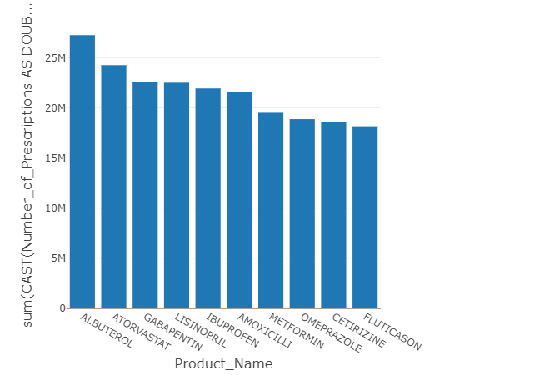
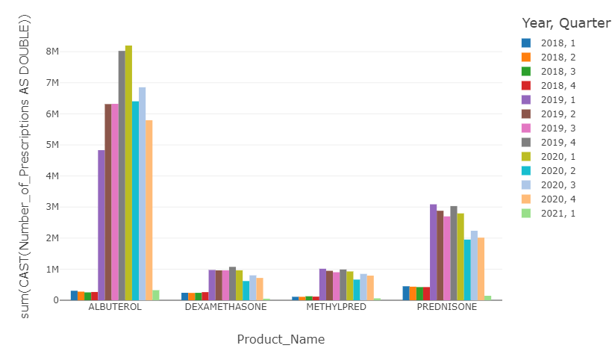
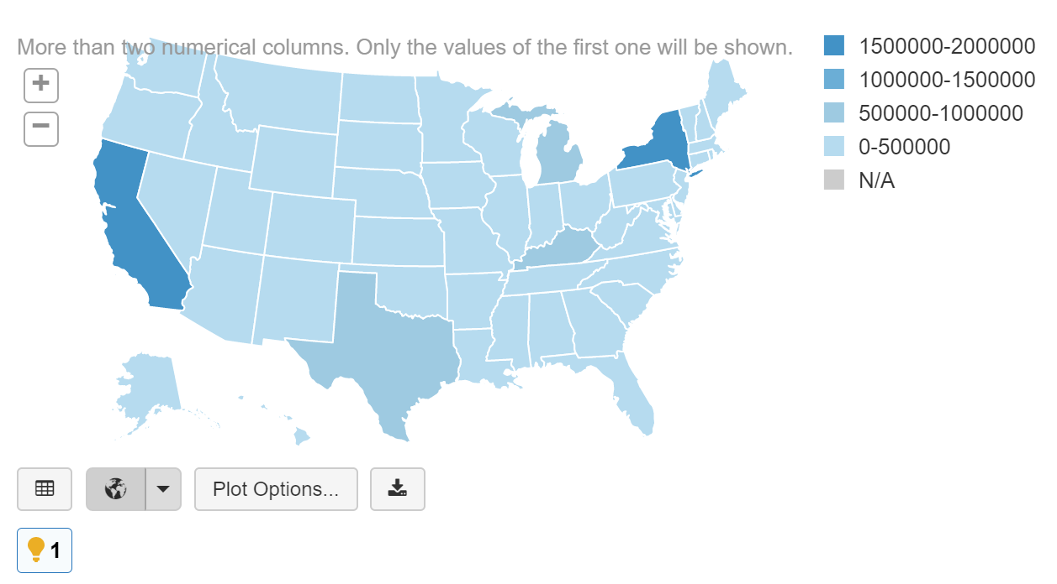
Analysis - State Drug Utilization
Albuterol (respiratory inhaler)
Top Rx in Q1 2020
Corticosteroids (anti-inflammatory)
2020 had a smaller increase in Rx comparable to Albuterol, but higher than in previous years
Highest number of prescriptions
Concentrated in the coastal states in 2020

Slide 18
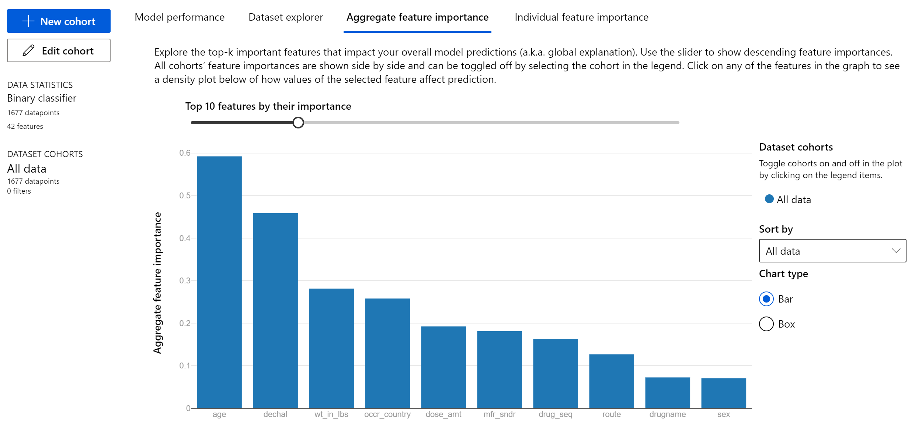
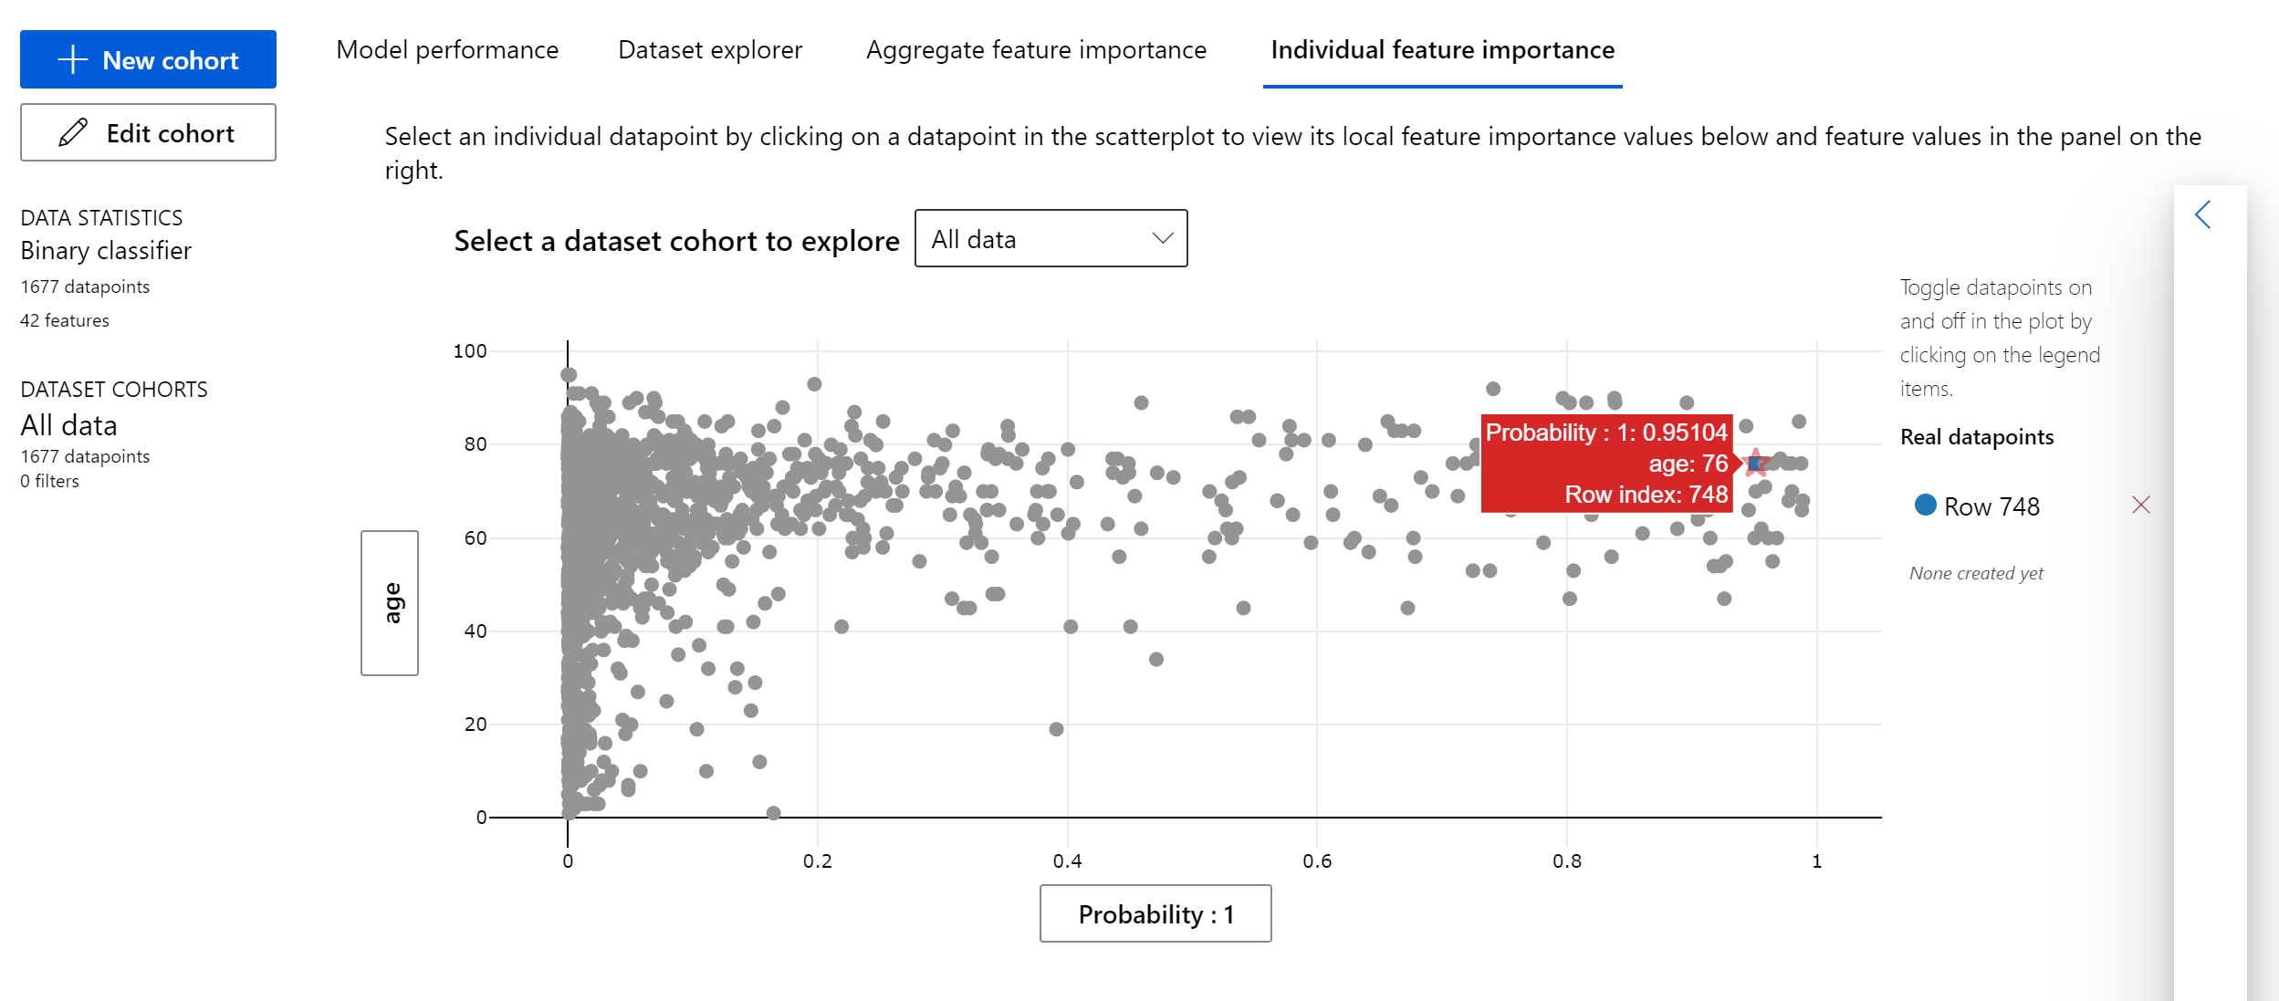
Analysis – FDA Adverse Events
Corticosteroid use
Per the NIH, corticosteroids are used to treat hospitalized COVID-19 patients who require supplemental oxygen
What outcomes were reported?
Death was a reported outcome with patients who were given these drugs
Patient Risk Factors
Top 5 contributors to death included a patient’s age, dechallenge, weight, the country of occurrence, and dose amount
Notes:
https://www.covid19treatmentguidelines.nih.gov/management/clinical-management/hospitalized-adults--therapeutic-management/
Dechallenge - whether the patient had a reaction abate when drug therapy was stopped

Slide 19
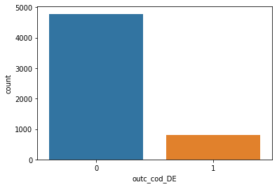
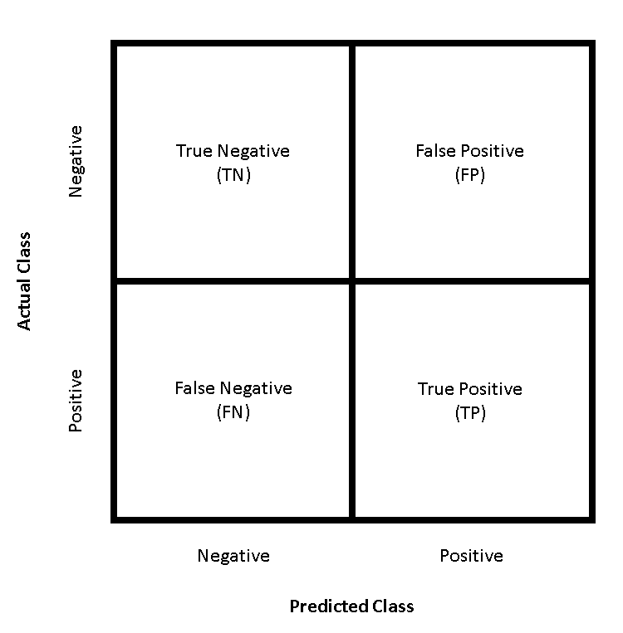
Model Selection
Classification Metric
Are the target classes (No Death vs. Death) balanced?
Accuracy is not always the best performance measure for imbalanced classes
Which outcome is more costly?
False positives (FP) vs. false negatives (FN)
FP - Patient predicted to die (1) but lived (0)
FN - Patient predicted to live (0) but died (1)
Minimize false positives and false negatives
Identifying patient risk factors is valuable in either case
F1-Score (0 is worst, 1 is best)
Notes:
This is a binary classification problem – that is, we are predicting an outcome of 0 (no death) or 1 (death)
https://www.stardat.net/post/confusion-matrix
https://medium.com/@douglaspsteen/precision-recall-curves-d32e5b290248

Slide 20
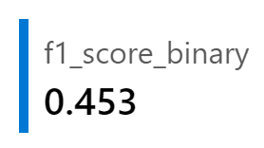

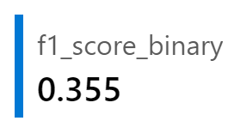

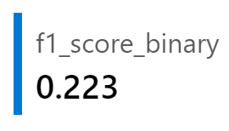
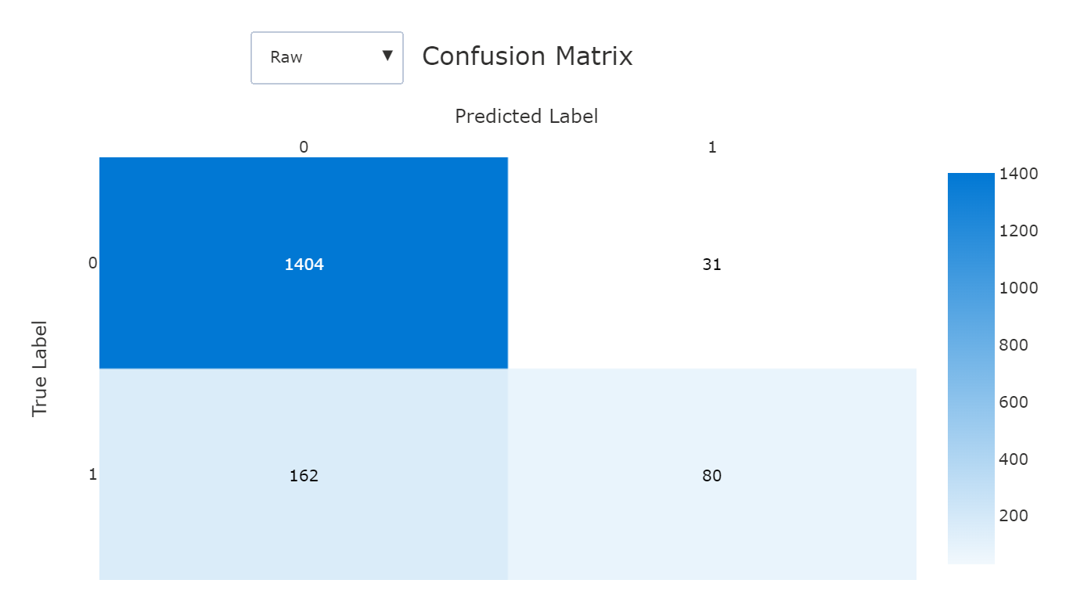
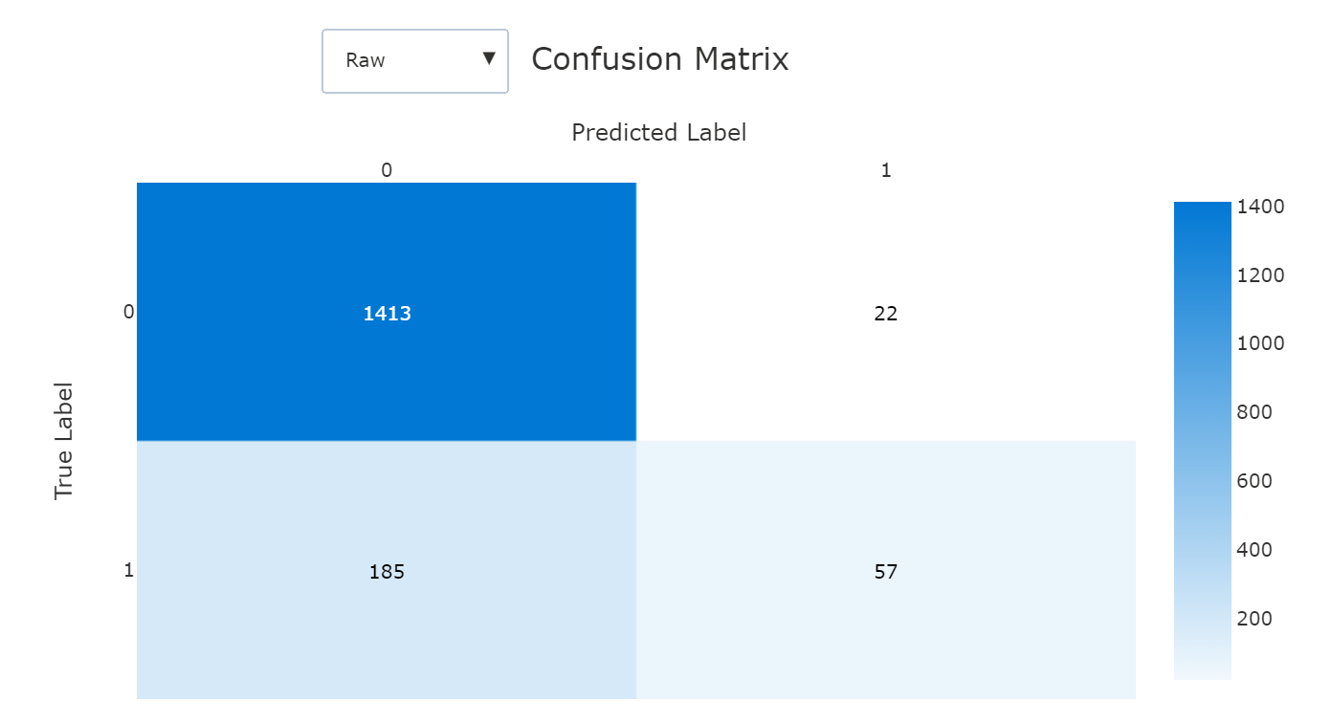
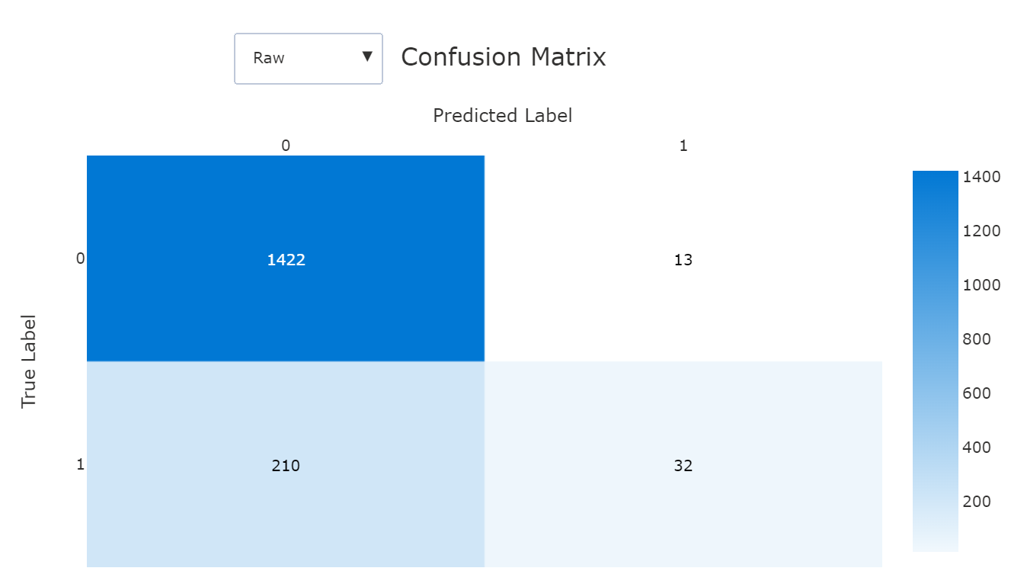
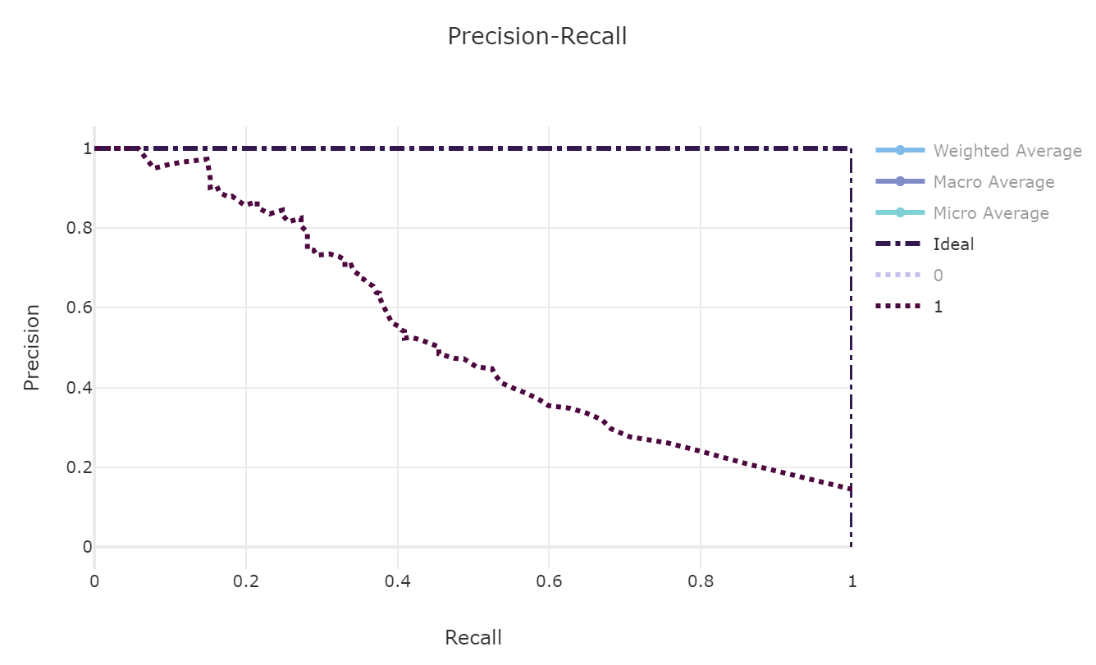
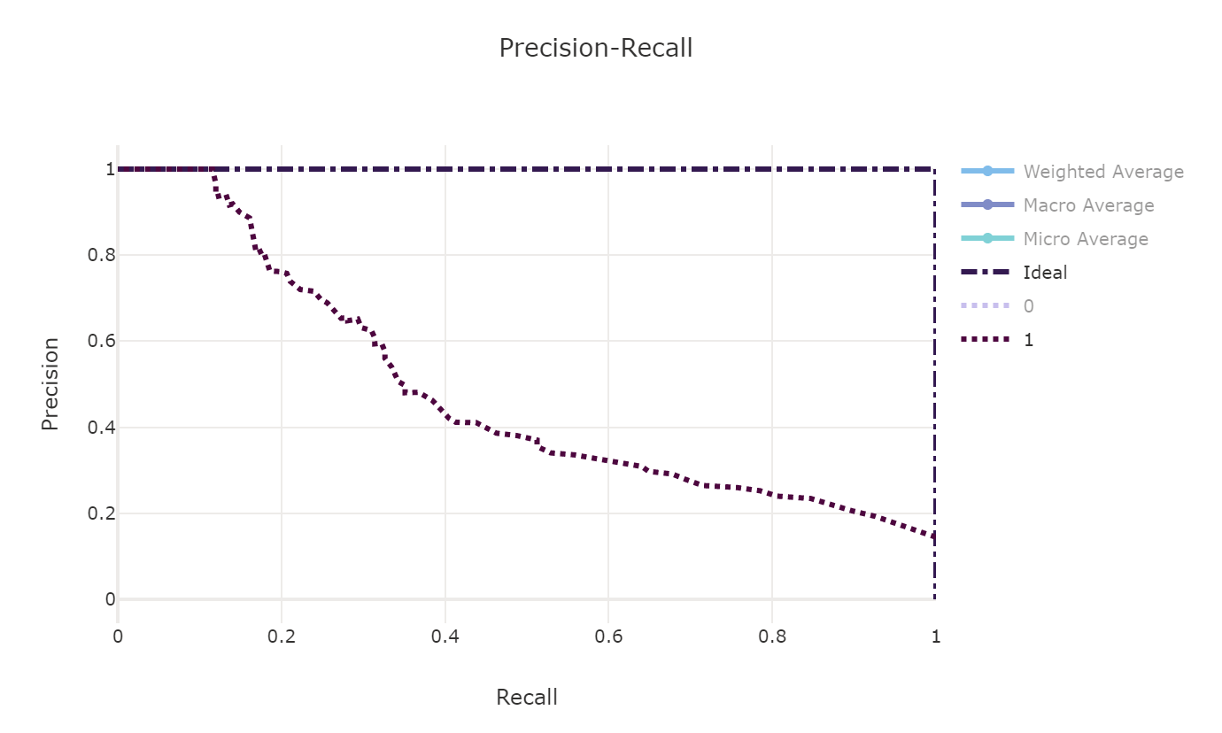
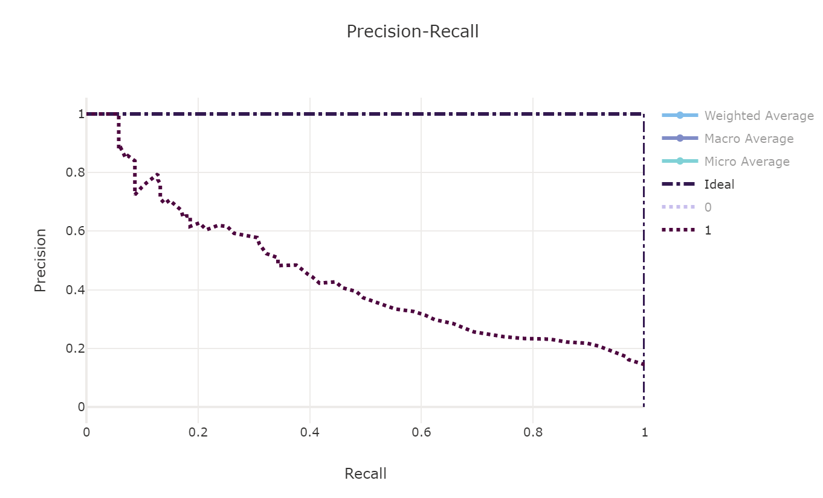
How well did our models do?
XG Boost
Light GBM
Random
Forest
Notes:
Modeling Strategy
- Train multiple models in Databricks notebook
- Benchmark against models generated by Azure Machine Learning autoML. Models displayed are from AML autoML.
- Models shown do not take into account hyperparameter tuning
XGBoost - https://ml.azure.com/experiments/id/228ec933-9b64-463b-b5b1-0c569915852f/runs/AutoML_ddf855b0-8c1b-4ff5-8819-4e382e39d00a_35?wsid=/subscriptions/9edd9e25-815c-4cdb-9bc8-d2ba127ec752/resourceGroups/2021-06-22_SDUD/providers/Microsoft.MachineLearningServices/workspaces/SDUDaml3&tid=72f988bf-86f1-41af-91ab-2d7cd011db47#metrics
Light GBM - https://ml.azure.com/experiments/id/228ec933-9b64-463b-b5b1-0c569915852f/runs/AutoML_ddf855b0-8c1b-4ff5-8819-4e382e39d00a_0?wsid=/subscriptions/9edd9e25-815c-4cdb-9bc8-d2ba127ec752/resourceGroups/2021-06-22_SDUD/providers/Microsoft.MachineLearningServices/workspaces/SDUDaml3&tid=72f988bf-86f1-41af-91ab-2d7cd011db47#metrics
Random Forest - https://ml.azure.com/experiments/id/228ec933-9b64-463b-b5b1-0c569915852f/runs/AutoML_ddf855b0-8c1b-4ff5-8819-4e382e39d00a_14?wsid=/subscriptions/9edd9e25-815c-4cdb-9bc8-d2ba127ec752/resourceGroups/2021-06-22_SDUD/providers/Microsoft.MachineLearningServices/workspaces/SDUDaml3&tid=72f988bf-86f1-41af-91ab-2d7cd011db47#metrics

Slide 21
Summary
2018–2021
What patterns were observed in drugs prescribed between 2018-2021?
Were any patterns related to the onset of COVID-19 in the US in 2019?
2019–2021
What Adverse Events were reported with these drugs from 2019-2021?
What risk factors were associated with patients who were given these drugs?
A significant number of prescriptions for Albuterol to treat respiratory symptoms, a chief patient complaint
Existing drugs, including potent corticosteroids, were repurposed to treat severe cases of COVID-19
Corticosteroids appear to be an effective treatment in preventing death
Where death was an adverse outcome of corticosteroid treatment, older age is a top patient risk factor

Slide 22
Demo (Back-end)

Slide 23
Q&A

Slide 24

Where can healthcare do better?
$1.8T
84%
Global pharmaceutical market estimated to reach by 2024 ⁴​
Healthcare executives believe AI will revolutionize the way they obtain information ¹
Patients unsatisfied with their current healthcare experience ⁵
​
81%
14M
Providers will suffer from a projected shortage of workers worldwide by 2030 ²
41%
Providers who say data and analytics challenges are preventing them from succeeding in value-based care models ⁶
​
150B
Projected savings for healthcare providers by 2026 with AI helping to prevent medication dosing errors ³
Notes:
1: https://healthitanalytics.com/
2: Global shortage in healthcare workers:
As populations age and health needs become more complex, providers are facing a global shortage of workers at the worst possible time.
By 2030, providers will suffer from a projected shortage of 14 million workers worldwide.
3. https://www.forbes.com/sites/forbestechcouncil/2019/06/28/the-top-ai-healthcare-trends-of-2019/#:~:text=AI%20startups%20have%20raised%20%244.3,can%20prevent%20medication%20dosing%20errors. AI startups have raised $4.3 billion across 576 deals in the last six years, and healthcare providers are projected to save almost $150 billion by 2026 with the help of AIs that can prevent medication dosing errors
4: https://www.evaluate.com/thought-leadership/pharma/evaluatepharma-world-preview-2019-outlook-2024. Worldwide prescription drugs sales predicted to reach $1.18trn in 2024, with a compound annual growth of 6.9%, significantly higher than the 1.7% CAGR between 2011-2018. There is significant optimism around the launch of new technologies and the approval of the first cell and gene therapies, resulting in prescription drug sales being forecast to reach $1.18trn in 2024.
5: Just as digital transformation in other industries has led to increased patient expectations, patients have higher expectations than ever towards their doctors, insurers and the treatments they receive. 81% of patient are unsatisfied with their current healthcare experience. (GE Healthcase Camden Group: the Current State of Patient experience. (https://www.pwc.com/us/en/industries/health-industries/patient-experience.html
6: PWC
41% of providers say challenges with data and analytics to accurately estimate costs is preventing them from succeeding in value-based care models.

Slide 25

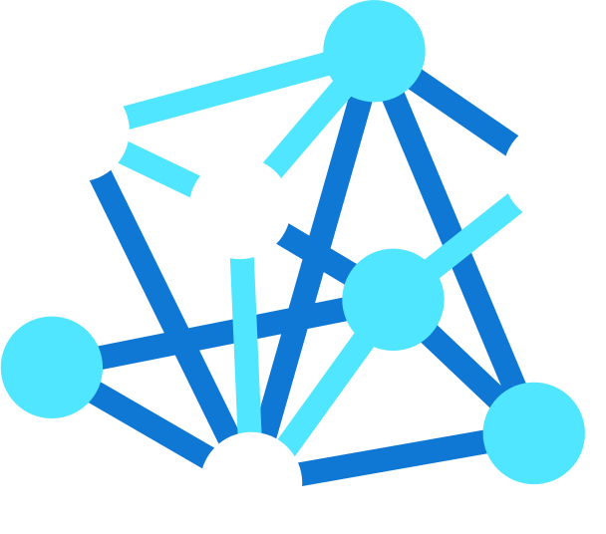

Using AI for Predictive Care Guidance Accelerate & ensure quality diagnostics for improved health, safety & lower costs
AI TRANSFORMATION
AI allows febrile individuals to be reliably identified & triaged for individualized care guidance
SOLUTION
Contact-free diagnosis & proactive intervention based upon predictive risk modeling
OUTCOMES
Easily identify those in need of guided care based upon presenting symptoms & personal history
Notes:
Using AI for Predictive Care Guidance Accelerate & ensure quality diagnostics for improved health, safety & lower costs
Predictive care includes identifying and facilitating preventative diagnosis and care plan. Use advanced medical imaging with AI to enhance safety and optimize triage by using AI based thermography to detect febrile individuals. Spot Febrile individuals quickly in a crowd to isolate for additional screening and fast track tests based on patient history and identified high-risk conditions.
AI TRANSFORMATION
AI allows individuals with presenting symptoms to be reliably spotted within a crowd without contact or privacy implications
By deploying AI-enabled solutions at the edge, crowds of people can be reliably ‘scanned’ in real-time any time & at any place – even as need is exponentially amplified
SOLUTION
Inference at the edge with a pre-trained model for diagnosing febrility without contact
Custom train Azure Computer Vision to improve diagnoses over time – even as symptoms evolve
Orchestrate model training, deployment & use over their entire lifecycle
OUTCOMES
Proactively ensure population health in highly occupied spaces
Easily identify those in need of healthcare without contact or violating their privacy
Proactively manage population health to avoid overwhelming public health systems by averting crises

Slide 26
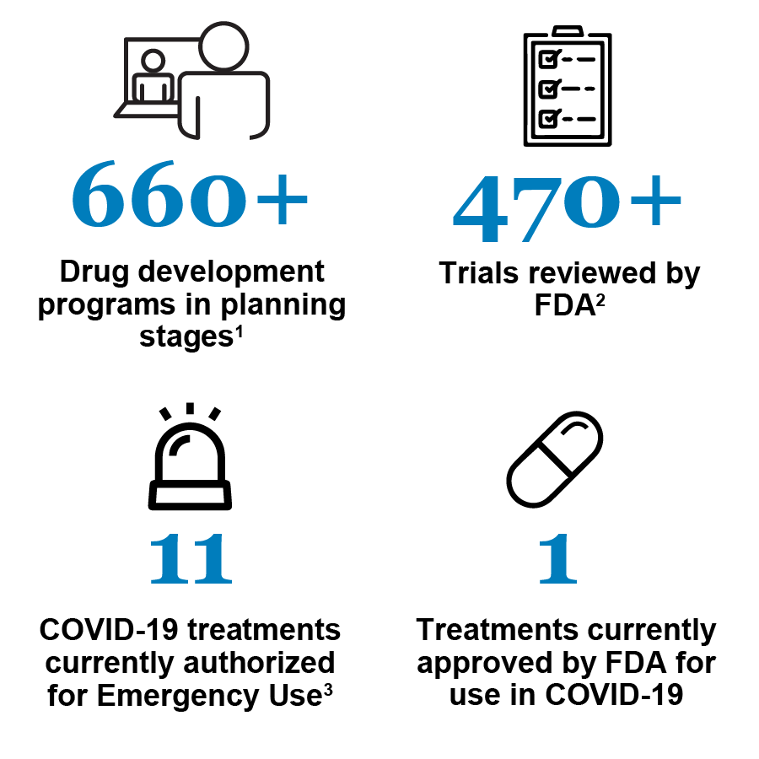

Developing COVID-19 therapeutics
CTAP
Special emergency program for possible coronavirus therapies created by the FDA
Monthly developments
Snapshot as of September 30, 2021
Notes:
https://www.fda.gov/drugs/coronavirus-covid-19-drugs/coronavirus-treatment-acceleration-program-ctap
https://www.fda.gov/news-events/fda-voices/path-forward-coronavirus-treatment-acceleration-program
https://www.fda.gov/consumers/consumer-updates/know-your-treatment-options-covid-19
While many of us have heard of vaccines circulating the news for many months now, did you know there are many drugs underway to treat or prevent COVID-19?
CTAP (Coronavirus Treatment Acceleration Program)
Use every available method to move new treatments to patients quickly
Determine whether therapies are helpful or harmful
Question: How can life science companies take advantage of available data sources to accelerate the development novel therapeutics to treat COVID-19 and/or other diseases?

Slide 27





The Life Sciences landscape: New Horizons
Real World Evidence collection
Precision medicine and genomics drive personalized diagnosis and research
Research & Development
Sales, Marketing & Consumer Engagement
Personalized customer engagement & rebates
Intelligent inventory planning and demand forecasting
Automated patient-trial matchmaking
Health Data Consortiums
Supply Chain & Logistics
Counterfeit detection
Clinical trials
Virtual trials and onboarding
Real-time asset tracking, cold chain supply tracking
Data sharing across the ecosystem
Manufacturing
Automated contract processing
Trial data analytics and modeling
Resource and production planning
Green chemistry and sustainable manufacturing
Manufacturing 4.0 practices enabled by smart factories
Notes:
What challenges did life science companies face during covid?

Slide 28
User Story
Groups:
- R&D - develop new drug targets for COVID-19
- Drug Safety – ensure that drug is safe for use in the public; drug labeling
Tool – Patient risk profiler
- Identify which patients who were diagnosed with COVID-19 and at risk of developing an AE based on the drug they received
- If a risk factor is age, further research is warranted to understand the current drug’s effects and improve upon/develop alternative treatments
Workflow
- Webpage – researcher enters patient demographics and current drug
- Is this patient at risk of developing an AE?
- Provide supporting literature for researcher to investigate (i.e.,
Additional ideas: Preparing for a clinical trial
- What tasks must a LS company prepare for in a clinical trial?
Notes:
For our meeting on Tuesday, I would like each of you to think through a workflow where your respective projects can fit in from a customer perspective. Please come prepared to discuss a story-board from a user perspective and what front-end interfaces you can build for your projects to complete the package.
For example, for Han’s project the story-board could involve a healthcare advocacy or guideline issuing body like NIH or The ADA. As part of the risk-assessment information they provide on their website, the bot Han developed would be deployed for any user to access and understand their risk for developing diabetes.
So Han could create a webpage for a made-up advocacy org., embed the bot, create a user persona and for a demo narrate the story of the user and showcase the bot.

Slide 29
Future Direction
Save tables as Delta Format
Develop Delta Bronze/Silver/Gold layers?
Query Delta table in Synapse
Delta in Synapse vs. Databricks
Spark optimizations on Databricks vs. Synapse Spark notebooks – which is more performant?
Take top 3 algorithms and see if can optimize F1-score. New algorithms?
Check which features have bias
Leverage AzureML SDK
Incorporate Responsible AI
Incorporate Purview
Advanced visualization – Preferred terms word cloud?
Inferencing (Predicting on new data)
Optimize notebooks for changing model parameters
Streaming data example?
Outcomes related to demographics (10/29/21)

Slide 30
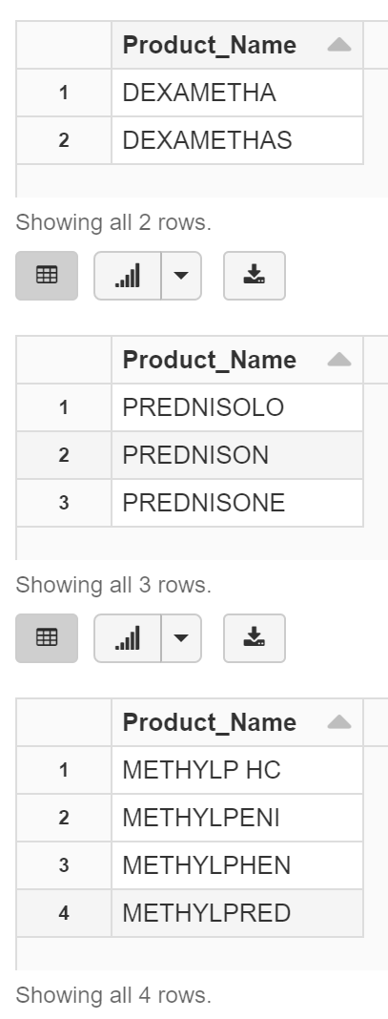
SDUD – Entity Resolution
# check for similar Product_Names
df_dex = df2_distinct.filter(df2_distinct.Product_Name.startswith('DEXAMET'))
df_pre = df2_distinct.filter(df2_distinct.Product_Name.startswith('PREDNIS'))
df_met = df2_distinct.filter(df2_distinct.Product_Name.startswith('METHYLP'))
display(df_dex)
display(df_pre)
display(df_met)
# consolidate Product_Name
from pyspark.sql.functions import when
df3 = df2.withColumn('Product_Name',
when(df2.Product_Name == "DEXAMETHA", "DEXAMETHASONE") \
.when(df2.Product_Name == "DEXAMETHAS", "DEXAMETHASONE") \
.when(df2.Product_Name == "PREDNISON", "PREDNISONE") \
.otherwise(df2.Product_Name))

Slide 31
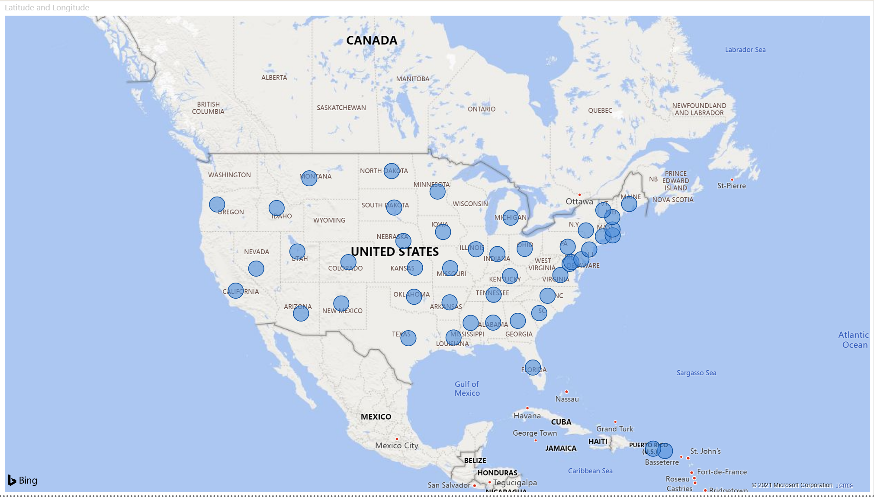
SDUD - PowerBI

Slide 32
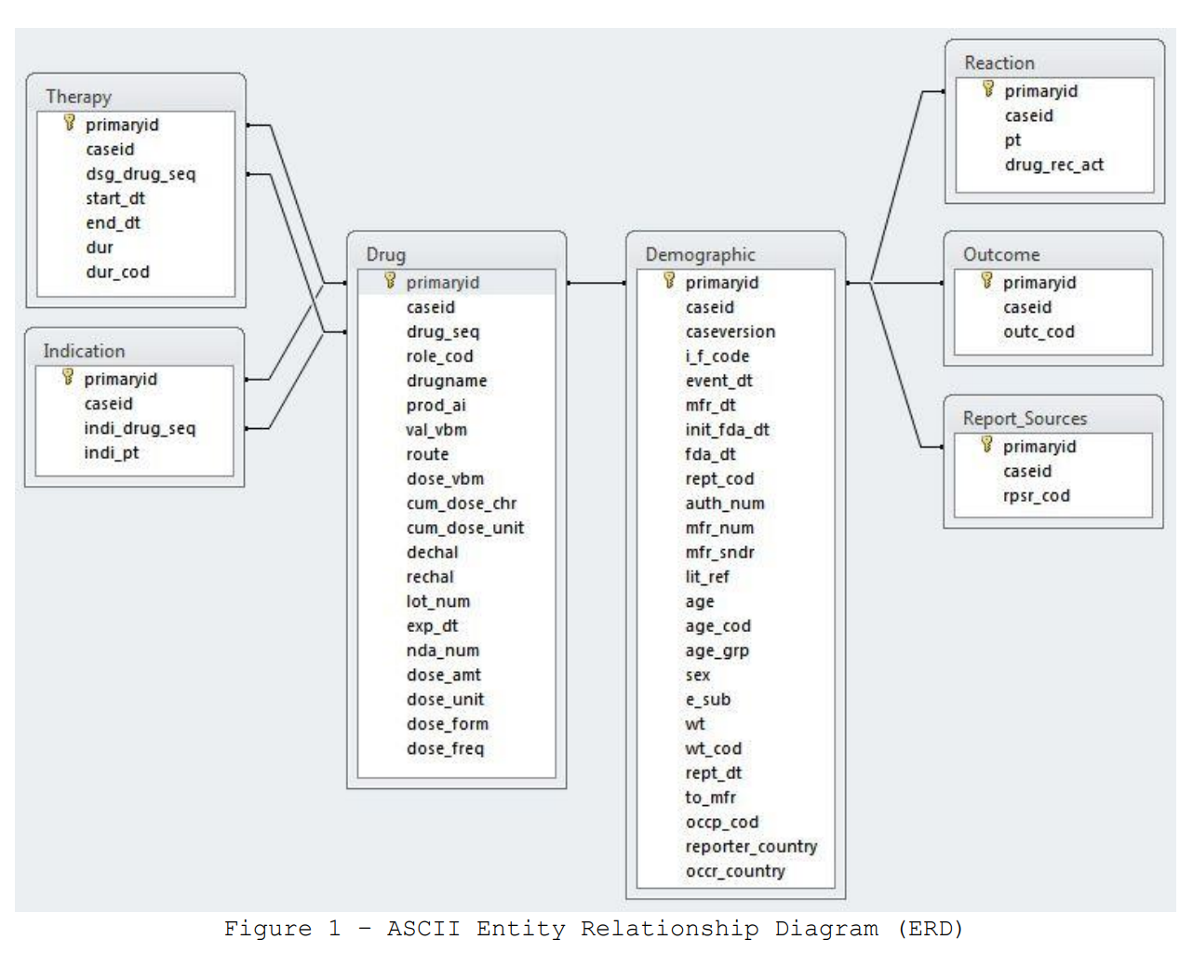
FAERS - ERD
Notes:
https://www.medicaid.gov/medicaid/prescription-drugs/state-drug-utilization-data/index.html
https://www.fda.gov/drugs/surveillance/questions-and-answers-fdas-adverse-event-reporting-system-faers

Slide 33
FAERS – Corticosteroid Join
df1 = spark.sql("select D.*, \
DR.drug_seq, DR.role_cod, DR.drugname, DR.prod_ai, DR.val_vbm, DR.route, DR.dose_vbm, DR.cum_dose_chr, DR.cum_dose_unit, DR.dechal, DR.rechal, DR.lot_num, DR.exp_dt, DR.nda_num, DR.dose_amt, DR.dose_unit, DR.dose_form, DR.dose_freq, \
R.pt, R.drug_rec_act, \
O.outc_cod, \
T.dsg_drug_seq, T.start_dt, T.end_dt, T.dur, T.dur_cod \
from 2020_DEMO1 D INNER JOIN 2020_DRUG DR \
ON D.primaryid = DR.primaryid \
INNER JOIN 2020_REAC R \
ON D.primaryid = R.primaryid \
INNER JOIN 2020_OUTC O \
ON D.primaryid = O.primaryid \
INNER JOIN 2020_THER T \
ON (DR.primaryid = T.primaryid and DR.drug_seq = T.dsg_drug_seq) \
WHERE \
DR.drugname IN ('DEXAMETHASONE.', 'PREDNISONE', 'PREDNISONE.', 'METHYLPREDNISOLONE.') ")

Slide 34
FAERS – Resolving multiple outcomes (outc_cod) when Death was present
TBD

Slide 35
FAERS – Individual Feature Importance (Age)

Slide 36
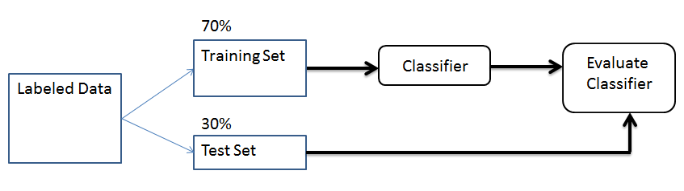
Model Selection – Classification Overview

Slide 37
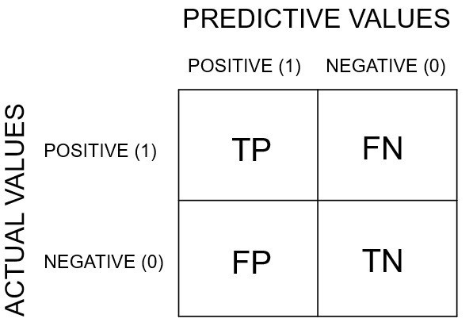
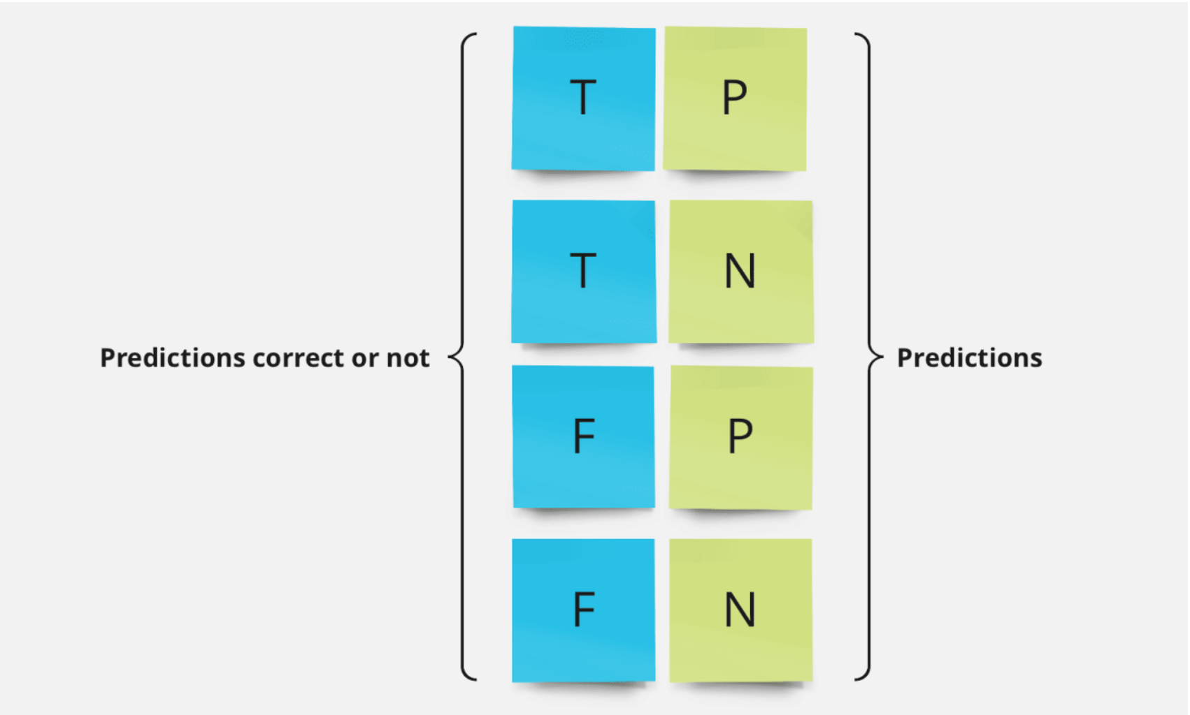
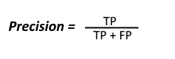
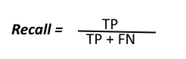
Model Selection – Confusion Matrix Overview

Slide 38
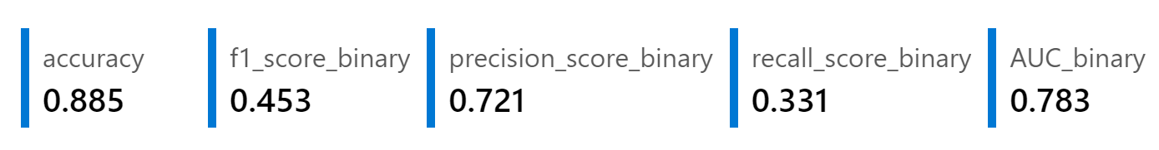
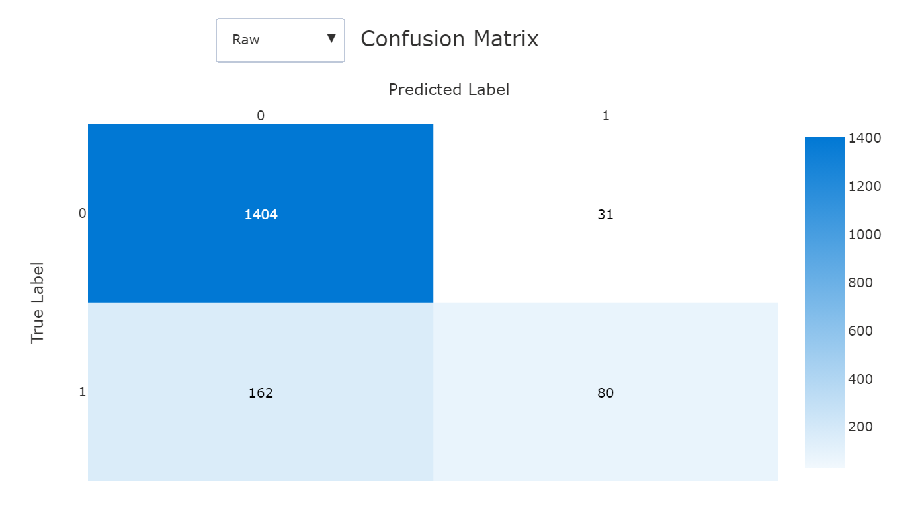
Model Selection – F-1 Score Details
Precision = TP / TP + FP
= 80 / 80 + 31
= 80 / 111
= 0.721
Recall = TP / TP + FN
= 80 / 80 + 162
= 80 / 242
= 0.331
F-1 Score = 2 * precision * recall
precision + recall
= 2 * 0.721 * 0.331
0.721 + 0.331
= 0.453
Notes:
https://towardsdatascience.com/understanding-confusion-matrix-a9ad42dcfd62
Precision (positive predictive value) – of all the classes we have predicted as positive, how many are actually positive?
Recall (sensitivity) – of all the positive classes, how many were predicted correctly?

Slide 39
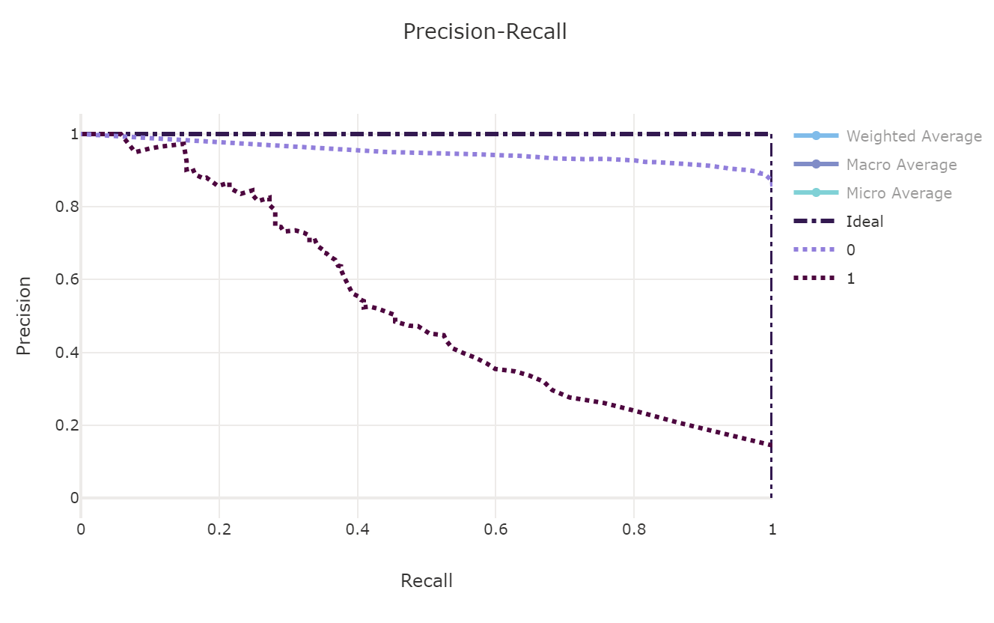
Model Selection – Precision-Recall Curves

Slide 40
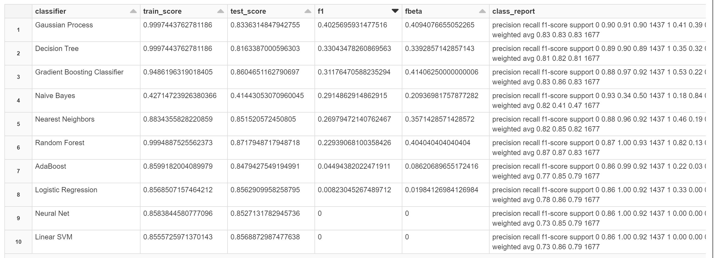
Model Selection – Batch Classifiers

Slide 41
Technical Choices – All Options
 | Data Engineering | Feature Engineering | Build + Train | Package + Deploy | Operational Analytics | Visualization
Low Code/No Code Experience
Code-first ML experience
Code-first ML experience on Apache Spark
Notes:
Spark optimizations – demo optimizations vs. Synapse

Slide 42



Azure Machine Learning & Azure Databricks Guidance – what to use when
 | Data Prep | Feature Engineering | Build + Train | Package + Deploy | Version Control + Monitoring | CI/CD
Low Code/No Code Data Science Projects
Code-first ML projects
Code-first ML projects on Apache Spark
+
: Azure Databricks workspace can be linked to Azure ML workspace for integration
: use for tracking run history and metrics; supported by the AML back end

Slide 43
Summary
The onset of COVID-19 in the US resulted in a significant number of prescriptions for Albuterol to treat respiratory symptoms
Existing drugs, including potent corticosteroids, were repurposed to treat severe cases of COVID-19
Based on the FAERS data, corticosteroids appear to be an effective treatment in preventing death
Where death was an adverse outcome of corticosteroid treatment, older age is a top patient risk factor
Notes:
What did we learn?
Future considerations
How can these outcomes inform drug manufacturers and doctors who prescribe them?
Older age and heavier weight appear to be key contributors to death as an adverse outcome of corticosteroids.
However, it is not entirely clear if this is a result of the patient being overcome by the disease despite corticosteroid treatment vs. corticosteroid treatment causing death

Slide 44
How well did our models do?
Update w/top 3 models
Models Tested
Logistic Regression
Nearest Neighbors
Linear SVM
Gradient Boosting Classifier
Decision Tree
Random Forest
Neural Net
Naive Bayes
AdaBoost
Gaussian Process
XG Boost (selected) - autoML
Notes:
Select algorithms that work well on imbalanced datasets
The selected model may have poor predictive value

Slide 45
Invent with purpose.

